Slide 1
Deterministic Finite Automaton (DFA)
CSC3113: Theory of Computation
2
1
Spring 2023-2024
Sharfuddin Mahmood, Assistant Professor,
Department of Computer Science, Faculty of Science & Technology.
smahmood@aiub.edu

Slide 2
Finite Automata (FA).
Example and Simulation of FA.
Finite state machine models.
Definition
Deterministic Finite Automata (all with examples)
Terminologies & State Diagram
Formal Mathematical Definition
Formal Computational Definition

Slide 3
Understand, learn & practice with example
Finite Automata (FA)
FA Machine Models
Finite State Machine
Deterministic Finite Automata (DFA)
Formal Definition of DFA
Computational Definition of DFA

Slide 4
All outcome are represented with examples
Know all the components of a finite state machine.
Learn the terminologies, conditions, and representation of the machine models.
How to define a machine model, along with its characteristics, using mathematical structure.
How to define the computation perform by the machine model using mathematical structure.
Understand the mathematical model for DFA
Students will be able to
Formally define a given DFA machine model
Run the machine for given input and determine if it is accepted or rejected.

Slide 5
Automata Theory
Automata comes from the Greek word (Αυτόματα) which means that something is doing something by itself.
Automata deals with the study of abstract (mathematical model) machines or systems (definition and properties) and the computational problems (defined in terms of formal languages) that can be solved (recognized) using these machines.
Automata are used as theoretical models for computing machines (input, process, output),
An automaton can be a finite representation of a formal language that may be an infinite set (language theory). Formal languages are the preferred mode of specification (input) for any problem that must be computed (processed).
These abstract computing machines are used for proofs about computability (solvability).
Such models include –
finite automaton, used in text processing, compilers, and hardware design
Context-free grammar, used in programming languages and artificial intelligence

Slide 6
Finite Automata
We will use several different models, depending on the features we want to focus on. Begin with the simplest model, called the finite automaton.
Good models for computing device with an extremely limited amount of memory.
For example, various household appliances such as dishwashers and electronic thermostats, as well as parts of digital watches and calculators.
The design of such devices requires keeping the methodology and terminology of finite automata in mind.
Next, we will analyze an example to get an idea of the methodology and terminology of finite automata and then we go for a formal definition.

Slide 7
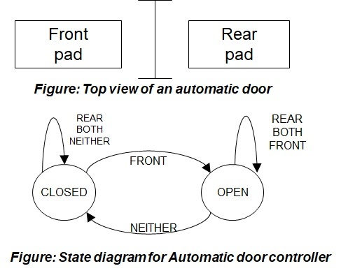
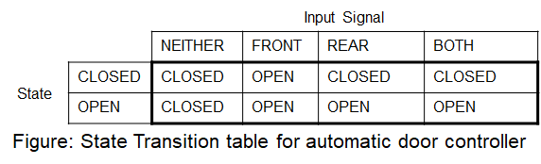
Automatic Door
Automatic doors swing open when sensing that a person is approaching.
An automatic door has a pad in front to detect the presence of a person about to walk through the doorway.
Another pad is located to the rear of the doorway so that –
The controller can hold the door long enough for the person to pass all the way through.
The door does not strike someone standing behind it as it opens.
An Example

Slide 8
Simulation – Automatic Door
Input Example:
Initial State: CLOSED
Input Signal Sequence: FRONT, REAR, NEITHER, FRONT, BOTH, NEITHER, REAR, NEITHER.
Present State:
CLOSED
OPEN
Input Signal:
REAR
FRONT
NEITHER
BOTH
REAR
REAR
BOTH
BOTH
NEITHER
FRONT
FRONT
CLOSED
OPEN
Front
pad
Rear
pad
NEITHER
Figure: Top view of an automatic door
Figure: State diagram for Automatic door controller

Slide 9
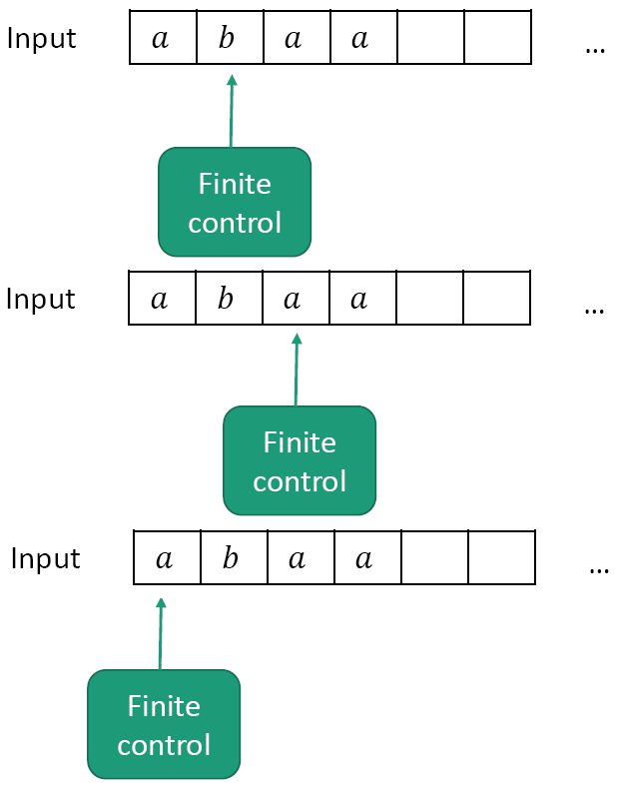
Machine Models
Computation is the processing of information by the unlimited application of a finite set of operations or rules.
Abstraction: We don’t care how the control is implemented.
We just require it to –
read a given input string
have a finite number of states, and
transition between states using fixed rules.
Finite State Machine

Slide 10
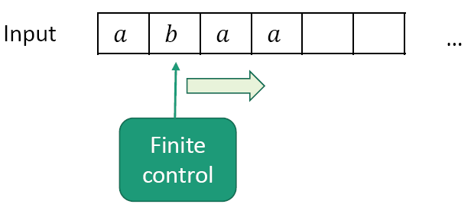
Machine Model
Finite Automata (FA)
Machine with a finite amount of unstructured memory.
Control scans a given input string only once (from some language) left-to-right, one by one.
Can check/match simple patterns (by transiting from state to state based on some given rules)
Can’t perform unlimited counting
Useful for modeling chips, simple control systems, adventure games…

Slide 11
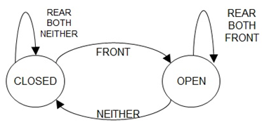
Finite Automata – definition
A finite automata has several parts –
It has a precise set of inputs (Language)
Example: FRONT, REAR, BOTH, NEITHER.
Set of states
Example: the auto door has CLOSED and OPEN states.
Initial (start) state must be defined
Example: CLOSED in the door example.
Rules for going from one state to another based on input Also known as transition rules.
Example: if door is in CLOSED state and [rule] someone is only on the front pad, then the door will go to OPEN state based on input, FRONT.
May have one or more state(s) as goal to reach from start state. Also known as set of final/accept states
Example: CLOSED as the last input signal is NIETHER in the door example.

Slide 12
Deterministic Finite Automata (DFA)
Every step of a computation follows in a unique way from the preceding step (deterministic computation).
When the machine is in a given state and reads the next input symbol, we know the next state will be – it is determined.
The transition rules are of the form –
Each state must have exactly one transition for each input from the input set to any individual state (including itself).
If there are n number of inputs, then each state must have exactly n transitions to any states (including itself).
There must be exactly one start state to start the transition and one or more final states to finish the transition.
Let us go through –
a precise definition of a deterministic finite automaton,
terminologies for describing and manipulating DFA,
theoretical results that describe their powers and limitations.
Let us now investigate the terminologies through an example.

Slide 13
Terminologies
Deterministic Finite Automata (DFA)
State Diagram
0
1
1, 0
q₁
q₂
q₃
1
0
3 states, labeled q₁, q₂, and q₃.
The start state is q₁, indicated by the arrow pointing at it from no where.
The accept state, q₂, is the one with a double circle.
The arrow going from one state to another (or to itself [loop]) are called transitions.
The symbol(s) along the transition is called label.
Each label is from input set {0, 1}.
From each state there are exactly one transition for each input 0 and 1.
M₁ works as follows –
The automaton receives the symbols from the input string one by one from left to right.
After reading each symbol, M1 moves from one state to another along the transition that has the symbol as its label.
When it reads the last symbol, M1 produces the output.
The output is ACCEPT if M1 is now in an accept state and REJECT if it is not.

Slide 14
Formal Definition - DFA
A Deterministic Finite Automaton (DFA) is a 5-tuple (Q, Σ, δ, q₀, F), where
Q is a finite set called the states,
Σ is a finite set called the alphabet,
δ : Q × Σ → Q is the transition function,
q₀ ∈ Q is the start state,
F ⊆ Q is the set of accept (final) states.
If A is the set of all strings that a machine M accepts, we say that A is the language of machine M and write L(M)=A, M recognizes A or M accepts A.

Slide 15
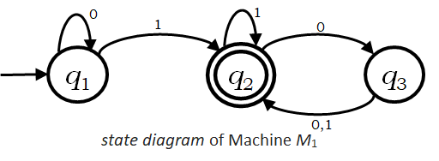
Formal Definition for Machine M₁
Example
M₁ = (Q, Σ, δ, q₀, F), where –
Q = {q₁ , q₂ , q₃} ,
Σ = {0, 1},
q₀ = q₁ ,
F = {q₂},
δ is describe as –
δ | 0 | 1
q₁ | q₁ | q₂
q₂ | q₃ | q₂
q₃ | q₂ | q₂
δ(q₁,0) = q₁, δ(q₁,1) = q₂,
δ(q₂,0) = q₃, δ(q₂,1) = q₂,
δ(q₃,0) = q₂, δ(q₃,1) = q₂.
OR
Transition Function
Transition Table

Slide 16
Formal Definition of DFA Computation
Now we formalize the Deterministic Finite Automaton’s computation, mathematically.
Let,
M = (Q, Σ, δ, q₀, F) be a DFA,
w = w₁w₂…w_{n} ∈ Σ* (a string over the alphabet Σ), where each w_{i} ∈ Σ.
Then M accepts w if a sequence of states r₀,r₁,…,r_{n} exists in Q with the following three conditions –
r₀=q₀,
δ(r_{i}, w_{i+1}) = r_{i+1}, for i = 0, 1, 2, … , n-1, and
r_{n} ∈F.
M recognizes language L if L = {w : M accepts w}.

Slide 17
Simulation – DFA Computation
0
1
1
0
q₁
q₂
q₃
ε
1101
1101
101
1
01
Figure: Finite Automaton M₁.
0,1
M=(Q, Σ, δ, q₀, F)=({q₁ , q₂ , q₃}, {0, 1}, δ , q₁, {q₂}) and δ = {δ(q₁,0)=q₁, δ(q₁,1)=q₂, δ(q₂,0)=q₃, δ(q₂,1)=q₂, δ(q₃,0)=q₂, δ(q₃,1)=q₂}
Input string w = w₁w₂w₃w₄ = 1101 to M₁ gives a sequence of states r₀,r₁,r₂,r₃,r₄ in the following computation (here n = 4) –
Start in state r₀ = q₁; → r₀=q₀,
δ(r₀,w₁) = δ(q₁,1) = q₂ = r₁; → δ(r_{i}, w_{i+1}) = r_{i+1}, for i = 0, 1, 2, … , n-1,
δ(r₁,w₂) = δ(q₂,1) = q₂ = r₂; → δ(r_{i}, w_{i+1}) = r_{i+1}, for i = 0, 1, 2, … , n-1,
δ(r₂,w₃) = δ(q₂,0) = q₃ = r₃; → δ(r_{i}, w_{i+1}) = r_{i+1}, for i = 0, 1, 2, … , n-1,
δ(r₃,w₄) = δ(q₃,1) = q₂ = r₄; → r_{n} ∈F.
Accept, as the machine M₁ is in an accept state q₂ at the end of the input string.
M₁ recognizes language L if L = {w : M₁ accepts w}.

Slide 18
DFA design issues
The key concept here is to understand the given language.
Type/pattern of input strings that the language gives.
Match the pattern from left to right with the states & transitions of the state diagram, one by one.
First match the necessary conditions with the transition then complete the diagram with rest of the transition maintaining the rules.
Maintain the rules –
From each state there must be exactly one transition for each input symbol.
Self-loop represents zero or more number of occurrences of the input symbol.
There can be one or more number of final states.
Make some of your own input strings based on the given language. Few that should be ACCEPTED and few that should be REJECTED. Test them on your state diagram after completing or while drawing the state diagram and update accordingly.
Let us practice some DFA in the following slides.

Slide 19
Designing DFA – Example 1
0
Alphabet Σ={0,1,2}.
Language A₁ = {w : the sum of all the symbols in w is multiple of 3 }.
Can be represented as follows –
S= the sum of all the symbols in w.
If S modulo 3 = 0 then the sum is multiple of 3.
So the sum of all the symbols in w is 0 modulo 3.
We can model a_{i} as state representing S modulo 3 = i.
The finite state machine M₁= (Q₁, Σ, δ₁, q₁, F₁), where –
Q₁ = {a₀,a₁,a₂},
q₁ = a₀,
F₁ = {a₀},
δ₁
| 0 1 2 . a₀ | a₀ a₁ a₂
a₁ | a₁ a₂ a₀
a₂ | a₂ a₀ a₁
a₁
1
2
1
2
0
a₀
2
a₂
1
0
Input example: 01120101
Present State:
Input symbol:
Accepted
a₂
a₁
a₀
01120101
01120101
01120101
01120101
01120101
01120101
ε
01120101
01120101

Slide 20
Designing DFA – Example 2
Alphabet Σ={0,1,2}.
Language A₂ = {w : the sum of all the symbols in w is an even number }.
Can be represented as follows –
S= the sum of all the symbols in w.
If S modulo 2 = 0 then the sum is even.
Here, b_{i} is modeled as S modulo 2 = i.
The finite state machine M₂= (Q₂, Σ, δ₂, q₂, F₂), where –
Q₂ = {b₀,b₁},
q₂ = b₀,
F₂ = {b₀},
δ₂
| 0 1 2 . b₀ | b₀ b₁ b₀
b₁ | b₁ b₀ b₁
b₀
1
b₁
0,2
1
0,2
Input example: 01120101
Present State:
Input symbol:
Accepted
b₀
b₁
01120101
01120101
01120101
01120101
01120101
01120101
01120101
01120101
ε

Slide 21
A3 ={w : w is a binary string containing an odd number of 1s}.
A4 ={w : w is a binary string containing an even number of 0s}.
∑ = {0,1}
0
0
1
q1
q2
A3
1
1
1
1
0
q1
0
q2
q3
A4
0

Slide 22
A5 ={w| w ends with a 0}.
A6 ={w| w begins with a 1}.
A7 ={w| w begins with a 1 and ends with a 0}.
∑ = {0,1}
1
1
q1
0
q2
0
A5
q3
0, 1
0
q1
1
q2
0, 1
A6
q4
1
0, 1
0
q1
1
q2
0
q3
0
A7
1

Slide 23
A8 ={w| w has at least two 1s}.
A9 ={w| w has at most two 1s}.
∑ = {0,1}
0
0
0, 1
1
1
A8
q1
q2
q3
0
0
0
1
1
1
A9
q1
q2
q3
q4
0, 1

Slide 24
A10 ={w| w has substring 101}.
A11 ={w| w has substring 011}.
∑ = {0,1}
0
1
A10
1
0
q10
1
q101
qs
q1
0, 1
0
1
0
0
1
q01
1
q011
A11
qs
q0
0, 1
0
What happens for the language, A11 ={w| w does not have substring 011}?

Slide 25
Practice the exercises
Introduction to Theory of Computation, Sipser, (3rd ed),
DFA; All Exercises;
Elements of the Theory of Computation, Papadimitriou (2nd ed), Chapter 1.

